Slide 1
LECTURE 21
LayOut Manager

Slide 2
LAYOUT MANAGER
Each Container object has a layout manager associated with it.
Container class belongs to java.awt.
A layout manager is an object that implements the LayoutManager interface and determines the size and position of the components within a container.
The layout manager is set by setLayout() method.
If no call to setLayout() is made, then default layout manager is used.

Slide 3
CREATING A LAYOUT MANAGER
Default layout managers
  JFrame, JDialog, JApplet have BorderLayout
  JPanel has FlowLayout
    Except when used as a Content Pane (Border Layout)
Setting the layout manager for a container
  JFrame frame = new JFrame();
  frame.setLayout(new FlowLayout());
  JPanel contentPane = new JPanel();
  contentPane.setLayout(new BorderLayout());

Slide 4
DIFFERENT TYPES OF LAYOUT MANAGER
FlowLayout
BorderLayout
GridLayout
CardLayout
GridBagLayout
Note:
All belongs to java.awt.

Slide 5

FLOWLAYOUT
Very simple - JPanel’s default
Components in row(s)
At preferred size
Costructors
FlowLayout()
FlowLayout(int align)
FlowLayout(int align, int h_gap, int v_gap)
Alignment
  FlowLayout.LEFT
  FlowLayout.CENTRE
  FlowLayout.RIGHT

Slide 6
EXAMPLE
import java.awt.Container;
import java.awt.FlowLayout;
import javax.swing.JLabel;
import javax.swing.JFrame;
class test_swing1
{
public static void main(String args[])
{
test tt=new test();
tt.setVisible(true);
}
}
class test extends JFrame
{
test(){
setTitle("Hello Solar System");
Container content=getContentPane();
content.setLayout(new FlowLayout());
content.add(new JLabel("Hello MerCury!"));
content.add(new JLabel("Hello Venus!"));
content.add(new JLabel("Hello Earth!"));
content.add(new JLabel("Hello Mars!"));
content.add(new JLabel("Hello Jupiter!"));
content.add(new JLabel("Hello Saturn!"));
content.add(new JLabel("Hello Uranus!"));
content.add(new JLabel("Hello Neptune!"));
content.add(new JLabel("Hello Pluto!"));
setDefaultCloseOperation(EXIT_ON_CLOSE);
pack();
}
}

Slide 7
OUTPUT

Slide 8
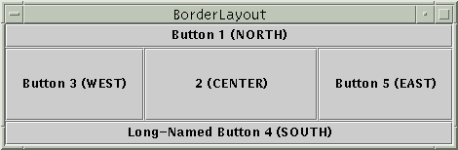
BORDERLAYOUT
Five areas
  NORTH, SOUTH, EAST, WEST and CENTER
  Not all areas must be used
  Do not assume a default area for components
  Centre gets as much area as possible
Specify location as argument of add method
  pane.setLayout(new BorderLayout());
  pane.add(new JButton(“Button 1 (NORTH)”), BorderLayout.NORTH);
Constructors:
  BorderLayout();
  BorderLayout(int horizontalGap, int verticalGap) - Constructor

Slide 9
BORDERLAYOUT
If you enlarge a container that uses BorderLayout, the center area gets as much of the available space as possible. The other areas expand only as much as necessary to fill all available space.

Slide 10
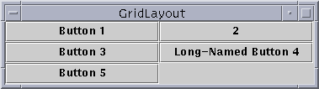
GRIDLAYOUT
Lays out components in two dimensional Grid. All cells are of same size.
Components take all space in a cell
Constructors:
GridLayout()
GridLayout( int rows, int columns)
GridLayout(int rows, int columns, int horz, int vert)
Gaps
  default = 5

Slide 11
EXAMPLE
import java.awt.Container;
import java.awt.GridLayout;
import javax.swing.JLabel;
import javax.swing.JFrame;
class test_swing1
{
public static void main(String args[])
{
test tt=new test();
tt.setVisible(true);
}
}
class test extends JFrame
{
test(){
setTitle("Hello Solar System");
Container content=getContentPane();
content.setLayout(new GridLayout(0,3,10,10));
content.add(new JLabel("Hello MerCury!"));
content.add(new JLabel("Hello Venus!"));
content.add(new JLabel("Hello Earth!"));
content.add(new JLabel("Hello Mars!"));
content.add(new JLabel("Hello Jupiter!"));
content.add(new JLabel("Hello Saturn!"));
content.add(new JLabel("Hello Uranus!"));
content.add(new JLabel("Hello Neptune!"));
content.add(new JLabel("Hello Pluto!"));
setDefaultCloseOperation(EXIT_ON_CLOSE);
pack();
}
}

Slide 12
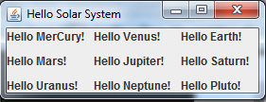
OUTPUT

Slide 13

CARDLAYOUT
It stores several different layouts.
Each layout can be thought of being as a separate index card in a deck that can be shuffled so that any card is on top at a given time.
One main panel (deck) whose layout manager is CardLayout. Object of type JPanel.
- (card) panels are object of type JPanel.
Card or component panels
Main or deck panel

Slide 14
CARDLAYOUT
Steps to Follow:
Construct the main (or deck) panel whose layout manager is CardLayout.
Construct other components panels.
Add the component panels to the main panel.
Provide some way for the user to select between cards.
Use add() to add the component panels to the main panel
void add( Component p_ob, String name);

Slide 15
CARDLAYOUT
Activate a card by calling one of the following methods defined by CardLayout:
void first(Container deck);
void last(Container deck);
void next(Container deck);
void previous(Container deck);
void show(Container deck, String cardName);

Slide 16
EXAMPLE
import javax.swing.*;
import java.awt.*;
import java.awt.event.*;
class card_lay extends JFrame implements ActionListener
{
JButton win,others;
CardLayout c_lay;
JPanel m_pane,c_pane, win_pane, other_pane;
Checkbox win98, winNT, solaris, mac;
String name1 = new String("windows");
String name2 = new String("other");
public card_lay()
{
super("Card Layout");
setSize(200,400);
setDefaultCloseOperation(EXIT_ON_CLOSE);
c_lay = new CardLayout();
c_pane = new JPanel();
win = new JButton("Windows");
others = new JButton("Others");
c_pane.add(win);
c_pane.add(others);
setContentPane(c_pane);
win98 = new Checkbox("Windows 98/XP", null, true);
winNT = new Checkbox("Windows NT/2000", null, true);
solaris = new Checkbox("Solaris", null, true);
mac = new Checkbox("MacOS", null, true);
win_pane = new JPanel();
win_pane.add(win98);
win_pane.add(winNT);
other_pane = new JPanel();
other_pane.add(solaris);
other_pane.add(mac);
m_pane = new JPanel(c_lay);
m_pane.add(win_pane,name1);
m_pane.add(other_pane, name2);
c_pane.add(m_pane);
win.addActionListener(this);
setVisible(true);
}

Slide 17
EXAMPLE
public void actionPerformed(ActionEvent e)
{
c_lay.next(m_pane);
}
public static void main(String args[])
{
card_lay ob = new card_lay();
}
}

Slide 18
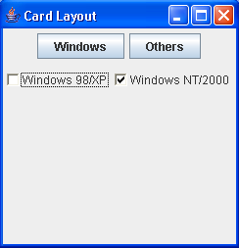
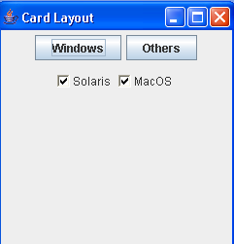
OUTPUT

Slide 19
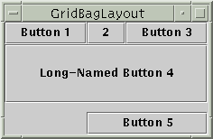
GRIDBAGLAYOUT
Very flexible
Can specify the relative placement of components by specifying their position within cells inside a grid.
Rows can have different height and columns can have different length.
Each row in the grid can have a different number of elements.

Slide 20
GRIDBAGLAYOUT
GridBagLayout:
The location and size of each component in a grid bag are determined by a set of constraints linked to it.
These constraints are contained in an object of type GridBagConstraint.
The constraints include:
- height and width of a cell
- placement of a component
- its alignment and anchor point within the cell.
Steps to Follow:
Create a GridBagLayout object and make it current layout manager.
Set the constraints
Add the components

Slide 21
GRIDBAGLAYOUT
setConstraints() of GridBagLayout.
void setConstraints(Component Ob, GridBagConstraints cons)
Example:
GridBagLayout gbg = new GridBagLayout();
GridBagConstraints gbc = new GridBagConstraints();
setLayout(gbg);
gbc.weightx = 1.0;
gbc.anchor = GridBagConstraints.NORTHEAST;
gbg.setConstraints(button, gbc);

Slide 22
Chapter 25 of your text book

